Slide 1

AGILE MODEL
The meaning of Agile is swift or versatile. "Agile process model" refers to a software development approach based on iterative development. Agile methods break tasks into smaller iterations, or parts do not directly involve long term planning. The project scope and requirements are laid down at the beginning of the development process. Plans regarding the number of iterations, the duration and the scope of each iteration are clearly defined in advance.
Each iteration is considered as a short time "frame" in the Agile process model, which typically lasts from one to four weeks. The division of the entire project into smaller parts helps to minimize the project risk and to reduce the overall project delivery time requirements. Each iteration involves a team working through a full software development life cycle including planning, requirements analysis, design, coding, and testing before a working product is demonstrated to the client.

Slide 2
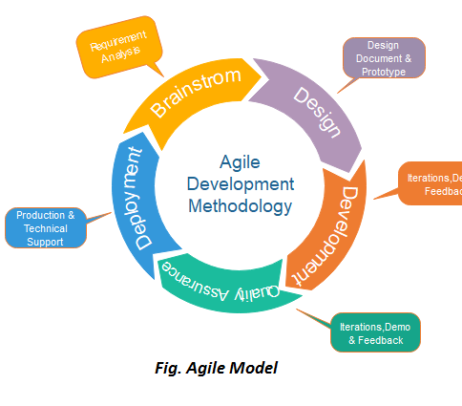
PHASES OF AGILE MODEL
Requirements gathering
Design the requirements
Construction/ iteration
Testing/ Quality assurance
Deployment
Feedback

Slide 3
PRINCIPLES OF AGILE MODEL
Satisfy Customers Through Early & Continuous Delivery
Welcome Changing Requirements Even Late in the Project
Deliver Value Frequently
Break the Silos of Your Project
Build Projects Around Motivated Individuals
The Most Effective Way of Communication is Face-to-face
Working Software is the Primary Measure of Progress
Maintain a Sustainable Working Pace
Continuous Excellence Enhances Agility
Simplicity is Essential
Self-organizing Teams Generate Most Value
Regularly Reflect and Adjust Your Way of Work to Boost Effectiveness

Slide 4
ADVANTAGES OF AGILE MODEL
Facilitates effective communication between teams and clients
Enhances project flexibility, easily handling sudden changes anytime
Cuts overall development time
Increases customer satisfaction via rapid, continuous delivery of a workable product
Delivers functioning software frequently, in weeks instead of months

Slide 5
DISADVANTAGESOF AGILE MODEL
Confusion between teams may develop because documentation wasn’t emphasized. This uncertainty can lead to difficult transitions between phases.
It is sometimes difficult to gauge how much effort will be needed to start the development life cycle of larger software deliverables.
If stakeholders project ladder are not on the same page, the project will derail.
The modeling isn’t for newbies. The sort of decisions involved in Agile require people with experience and solid developer and programming skills.

Slide 6
Characteristics of agile
Scrum
Quality
Visibility
Early identification and resolution of issues
Accommodating change due to volatile requirements (Flexibility / Agility)
Iterative releases, Communication, continuous integration
More Enjoyable!
Transparency
Early and Predictable Delivery
Predictable Costs and Schedule

Slide 7
SCRUM
SCRUM is an agile development process focused primarily on ways to manage tasks in team-based development conditions.
There are three roles in it, and their responsibilities are:
Scrum Master: The scrum can set up the master team, arrange the meeting and remove obstacles for the process
Product owner: The product owner makes the product backlog, prioritizes the delay and is responsible for the distribution of functionality on each repetition.
Scrum Team: The team manages its work and organizes the work to complete the sprint or cycle

Slide 8
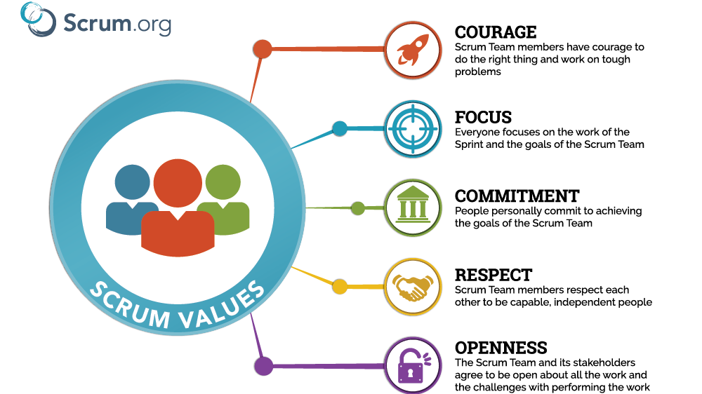
VALUES OF SCRUM

Slide 9

COURAGE
Display courage by pushing yourself beyond your comfort zone to achieve success. By staying committed to the goal and focusing less on yourself, you can solve challenging problems and produce unexpected results.
Be willing to confront the unknown. If you encounter things you don’t understand or identify a problem, don’t be afraid to ask tough questions. Your ability to speak honestly and question the status quo may be the key to driving improvement during a particular sprint.
A combination of these values contributes significantly to a team’s overall performance. Add in motivation, enthusiasm, and drive, and you’ll have the formula to keep morale high at all times.

Slide 10
FOCUS
Focus is about staying on track and helping other team members do the same. A key part of the Scrum methodology is the sprint — a time-bound and defined work period for completing a series of tasks.
To focus on these tasks, your team must eliminate distractions and multitask as much as possible. Distractions can cause setbacks that lengthen the time necessary to complete tasks. The end result is excessive overtime work, which defeats the purpose of using an agile methodology.
Standup Meetings are a great opportunity to explain the sprint goal and plan what will be completed within this timeframe. To help team members focus, Scrum masters should talk openly about individual workloads to ensure they only assign an achievable number of tasks. Take on too many objectives, and everyone will feel overwhelmed.

Slide 11

commitement
In this context, commitment is about staying dedicated to the objectives you developed as a team.
Contributing to team success and meeting daily challenges is crucial, but it’s equally important to speak up if the project is off track. Scrum teaches you to seek continuous improvement and optimize your efforts. So, a crucial part of commitment is reflecting on the common goal and making sure you’re prioritizing tasks that actually add value. Scrum masters can help foster commitment through good communication and proper sprint planning.

Slide 12
respect
Respect requires treating people as equals regardless of age, education, social position, etc. Who your co-workers are outside of the Scrum team doesn’t matter; all that matters is how they work together on team goals. It’s also about respecting and understanding customers and stakeholders, so you’re better equipped to meet their needs.
Respect means that teammates should appreciate each other for their strengths in terms of hard and soft skills. It also means respecting others’ decisions and opinions even if you disagree with them.
The Scrum Guide emphasizes the need to trust others on your team once roles are assigned. You shouldn’t micromanage what everyone else is doing or constantly undermine someone else’s skills by trying to take over their role. Respect enables better communication between members of different roles, as well as the ability to accept constructive criticism without letting it affect your ego.

Slide 13

openness
Openness means being open-minded in terms of communication between members of different disciplines. Foster a culture that welcomes new ideas and styles of working, which can help the team move forward.
Being open as an individual also means being honest about what you can achieve and how your work will affect other team members. If there isn’t a culture of transparency, bottlenecks, roadblocks, and missed deadlines will soon follow.

Slide 14
PRINCIPLES OF SCRUM
1.Control over the empirical process
2.Self Organisation
3.Collaboration
4.Value based prioritization
5.Time-boxing
6.Iterative Development

Slide 15
Principles of SCRUM
1. Control over the empirical process.
In Scrum, the empirical process is based on observation of hard evidence and experimentation rather than theory. There are three main ideas to empirical process control: transparency, inspection, and adaptation.
2. Self-organization.
As the Scrum process relies on many individuals, self-organization is essential. Everyone involved is empowered to work independently, and the self-organization principle allows for greater buy-in among all parties, while making it easier to assess individual contributions.
3. Collaboration.
Scrum is a collaborative process, as evidenced by the many roles involved (more on that below). This principle also focuses on three dimensions of collaboration: awareness, articulation, and appropriation.
4. Value-based prioritization.
This principle involves organizing and prioritizing tasks based on their value and how they need to be completed.
5. Time-boxing.
In Scrum, tasks are completed in “sprints,” with specific lengths of time assigned to each one. Other elements, including “sprint planning” and daily meetings, are also given specific start and stop times. This time-boxing ensures that all involved know how much time is allocated to each step, with the goal of eliminating wasted time and delays.
6. Iterative development.
This final principle speaks to the understanding that a project may need to be refined multiple times during the development process. Iterative development allows the team to make adjustments and manage change easier.

Slide 16
KANBAN
The Japanese word “kanban”, meaning “visual board” or a “sign”, has been used in the sense of a process definition since the 1950s. It was first developed and applied by Toyota as a scheduling system for just-in-time manufacturing. On the other hand, the capitalized term “Kanban” is known and associated with the emergence of the “Kanban Method,” which was first defined in 2007.
Kanban is a popular Lean workflow management method for defining, managing, and improving services that deliver knowledge work. It helps you visualize work, maximize efficiency, and improve continuously. Work is represented on Kanban boards, allowing you to optimize work delivery across multiple teams and handle even the most complex projects in a single environment.
Kanban is a popular framework which is used to implement agile software development. It takes real time communication of capacity and complete transparency of work. The work items are represented in a kanban board visually, allowing team members to see the state of every piece of work at any time.

Slide 17
Principles of kanban
1.Initiate with the existing workflow
1
2. Limit the existing tasks
2
4. Continuous
improvement
4
3. Focus on flow
3

Slide 18
prinCIPLES OF KANBAN
1.Initiate with the existing workflow:
Kanban framework emphasizes on making small and gradual changes. Therefore, the team must start with the existing workflow and continuously improve the process.
2. Limit the existing tasks:
It is important for the team to realize its own limits and cap the WIP accordingly. Taking on more than you can handle will only waste time and negatively affect the project.
3.Focus on Flow :
The third principle pertains to focusing on the flow of production and the process. The Kanban board implemented in the first step provides a great tool to observe how work is moving from one operation to the next. This will highlight any potential bottlenecks and allow managers to focus on interruptions in the normal flow.
4.Continuous Improvement :
The last principle of Kanban is continuous improvement. This is a common theme in most lean manufacturing methods. Unless you are operating at maximum efficiency, you will need to keep improving. As you start implementing Kanban and lean manufacturing principles within your operations, you will need to adjust to keep this improvement.

